Slide 1
2025 Erdos Institute
Quantitative Finance Fall Cohort: Mini-projects
David Ding

Slide 2
Mini-Project 1
Summary:
Validated the CRR model by showing its European call prices converge to Black–Scholes as the number of steps increases. With zero dividends (𝑞=0), the American call ≈ European call (no early-exercise benefit), while the American put ≥ European put due to early exercise.
Goal: Compare European and American option pricing using CRR vs Black–Scholes, and quantify the value of early exercise.
Impact-focused:
Establish a reproducible framework to price options, verify model correctness (CRR ≈ BS for Europeans), and explain why/when American options are worth more due to early exercise.

Slide 3
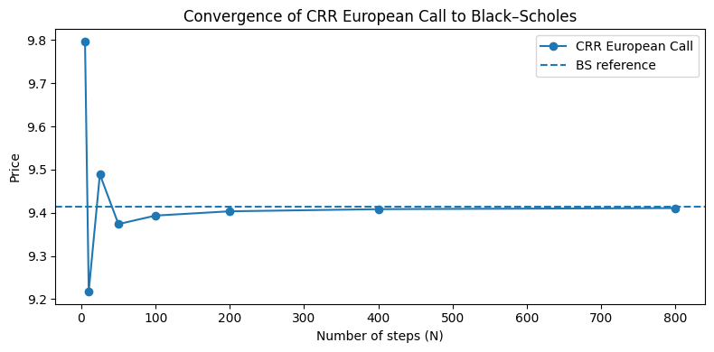
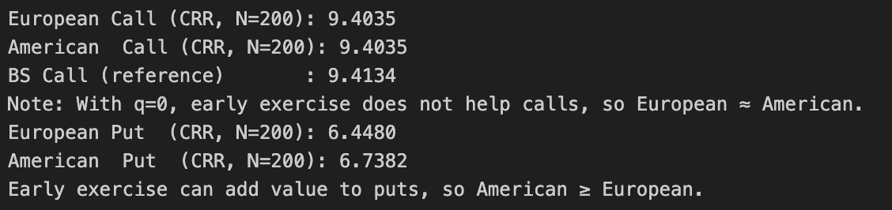
\
Mini-Project 1
CRR European call prices as you increase binomial steps N, with a dashed Black–Scholes reference.
CRR converges to BS as N grows (model is implemented correctly).
By around N≈200, the CRR price is within ~10^{-2} of BS for the ATM call —visually indistinguishable by N≥400.
Convergence is faster for smooth European payoffs
X-axis = N; Y-axis = price.
The CRR curve approaches the flat B-S line.

Slide 4
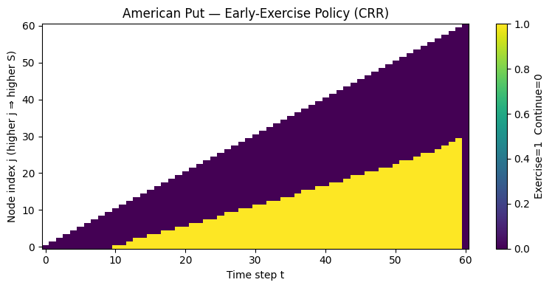
Mini-Project 1
A grid over time vs. stock price marking Exercise vs Continue regions.
Exercise region expands when 𝑆≪𝐾 (deep ITM) and near maturity—the put’s time value is low and the interest on 𝐾 favors exercising.
For higher 𝑆 or earlier times, Continue dominates (keep optionality).
Explains why American put ≥ European put; for calls with q=0 there’s no exercise region (never optimal to exercise early).
X-axis = stock price S; Y-axis = time (near maturity at the bottom). Colored cells indicate the optimal choice.

Slide 5
Mini-Project 2
Goal: Price futures and options on futures using cost-of-carry and Black–76, compute implied volatility, and illustrate sensitivities/hedging.
Objectives:
Derive 𝐹_0 from 𝑆​_0 (carry = 𝑟 + storage−convenience/dividends).
Price calls/puts, validate futures put–call parity, and generate price vs strike/vol plots.
Solve for implied vol from a target price; demonstrate delta (futures) hedge with a 1-step P&L.
Impact-focused:
Build a practical toolkit to map spot → futures, price and invert (implied vol) under Black–76, and apply basic hedging insights (delta/vega) for decision-making.

Slide 6
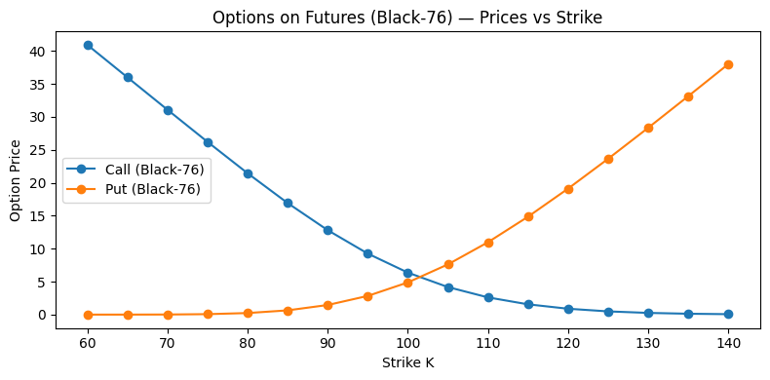
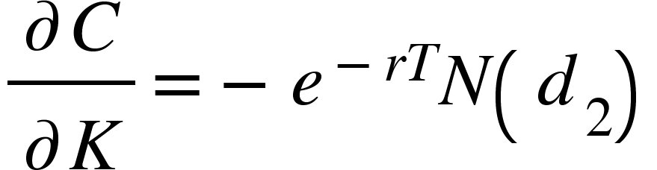
Mini-Project 2
Call premium as strike K varies; futures F_0​ and r,T,σ fixed.
Higher 𝐾 ⇒ lower option value (less intrinsic + lower exercise chance).
Convexity reflects option time value; curvature grows with higher𝜎 or longer 𝑇.
Local slope (negative), useful for intuition and checks.
Good caption: “Black–76 call price falls and is convex in 𝐾; curvature captures time value.”

Slide 7
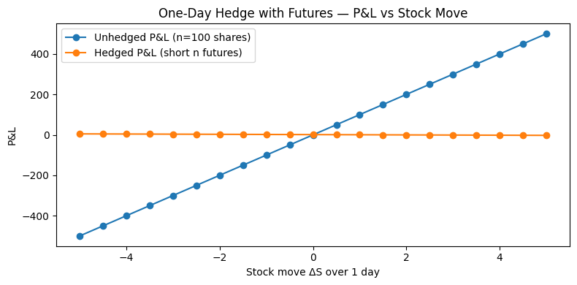
Mini-Project 2
Call premium as volatility 𝜎 changes at (near)-ATM 𝐾.
Vega > 0: more uncertainty ⇒ more upside optionality ⇒ higher price.
Sensitivity (vega) is largest near ATM and increases with √T; deep ITM/OTM options are less 𝜎-sensitive.
Good caption: “Call value rises with volatility; vega peaks near ATM.”
Tiny Hedging with Futures (1-step P&L)

Slide 8
Mini-Project 3
Goal: Price Asian options and compare geometric-average (closed-form) vs arithmetic-average (Monte Carlo), using geometric Asian as a control variate to cut variance.
Methods implemented:
Closed-form geometric Asian: continuous sampling and equally-spaced discrete sampling.
Arithmetic Asian via Monte Carlo (simulate GBM paths, average prices, discount).
Control variate: subtract scaled geometric-Asian payoff and add back closed-form price.
Key results (N=12, M=10,000):
Geometric (continuous): Call 5.0865, Put 3.9477.
Geometric (discrete, N=12): Call 5.4353, Put 4.1714.
Arithmetic (plain MC): 5.5276 ± 0.1608 (95% CI).
Arithmetic (control variate): 5.4658 ± 0.0043 (95% CI), with β≈1.03→ ~38× narrower 95% CI (~1,416× lower variance) than plain MC.

Slide 9
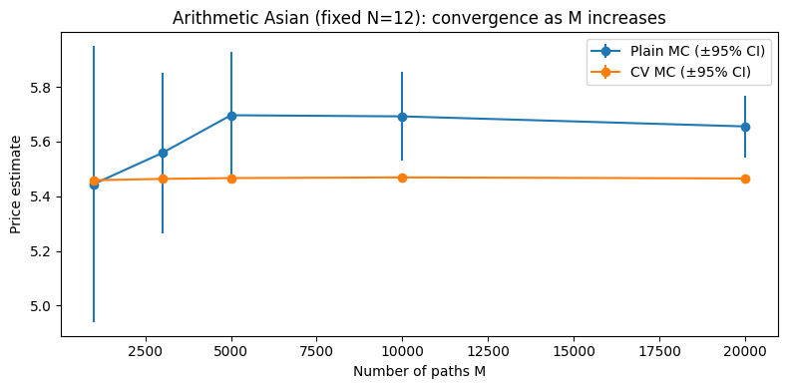
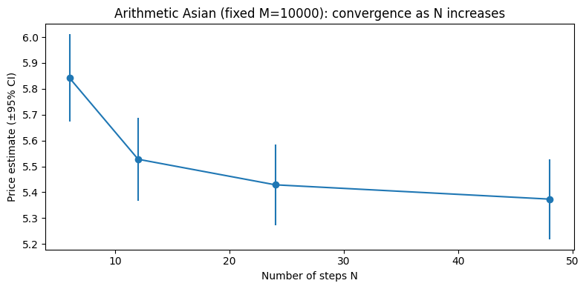
Mini-Project 3

Slide 10
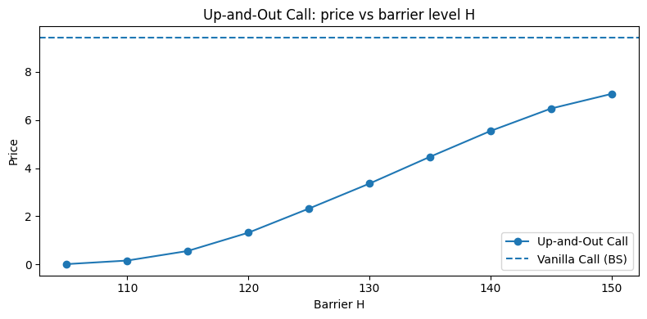
Mini-Project 4

Slide 11
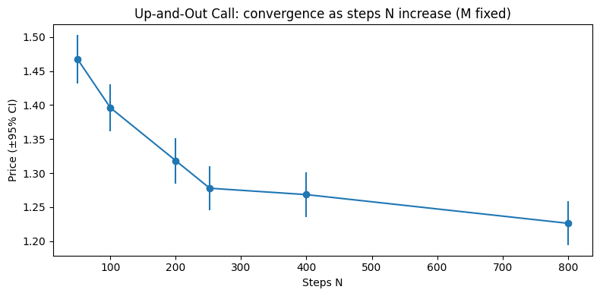
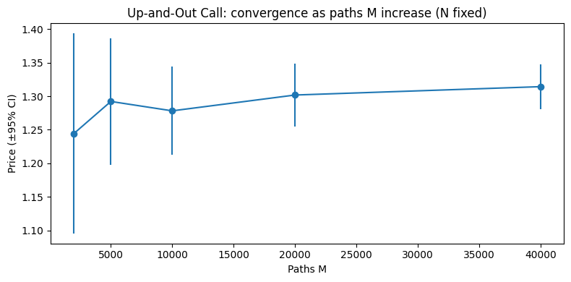
Mini-Project 4

